Slide 1

Chapter 10
Error Detection
and
Correction
10.
Copyright © The McGraw-Hill Companies, Inc. Permission required for reproduction or display.

Slide 2

Note
The Hamming distance between two words is the number of differences between corresponding bits.
10.

Slide 3

Example 10.4
Let us find the Hamming distance between two pairs of words.
1. The Hamming distance d(000, 011) is 2 because
2. The Hamming distance d(10101, 11110) is 3 because
10.

Slide 4
Note
The minimum Hamming distance is the smallest Hamming distance between
all possible pairs in a set of words.
10.

Slide 5
Example 10.5
Find the minimum Hamming distance of the coding scheme in Table 10.1.
Solution
We first find all Hamming distances.
The d_{min} in this case is 2.
10.

Slide 6
Example 10.6
Find the minimum Hamming distance of the coding scheme in Table 10.2.
Solution
We first find all the Hamming distances.
The d_{min} in this case is 3.
10.

Slide 7
Note
To guarantee the detection of up to s errors in all cases, the minimum
Hamming distance in a block
code must be d_{min} = s + 1.
10.

Slide 8
Example 10.7
The minimum Hamming distance for our first code scheme (Table 10.1) is 2. This code guarantees detection of only a single error. For example, if the third codeword (101) is sent and one error occurs, the received codeword does not match any valid codeword. If two errors occur, however, the received codeword may match a valid codeword and the errors are not detected.
10.

Slide 9
Example 10.8
Our second block code scheme (Table 10.2) has d_{min} = 3. This code can detect up to two errors. Again, we see that when any of the valid codewords is sent, two errors create a codeword which is not in the table of valid codewords. The receiver cannot be fooled.
However, some combinations of three errors change a valid codeword to another valid codeword. The receiver accepts the received codeword and the errors are undetected.
10.

Slide 10

Figure 10.8 Geometric concept for finding d_{min} in error detection
10.

Slide 11

Figure 10.9 Geometric concept for finding d_{min} in error correction
10.

Slide 12
Note
To guarantee correction of up to t errors in all cases, the minimum Hamming distance in a block code
must be d_{min} = 2t + 1.
10.

Slide 13
Example 10.9
A code scheme has a Hamming distance d_{min} = 4. What is the error detection and correction capability of this scheme?
Solution
This code guarantees the detection of up to three errors
(s = 3), but it can correct up to one error. In other words,
if this code is used for error correction, part of its capability is wasted. Error correction codes need to have an odd minimum distance (3, 5, 7, . . . ).
10.

Slide 14
10-3 LINEAR BLOCK CODES
Almost all block codes used today belong to a subset called linear block codes. A linear block code is a code in which the exclusive OR (addition modulo-2) of two valid codewords creates another valid codeword.
Topics discussed in this section:
Minimum Distance for Linear Block Codes
Some Linear Block Codes
10.

Slide 15
Note
In a linear block code, the exclusive OR (XOR) of any two valid codewords creates another valid codeword.
10.

Slide 16
Example 10.10
Let us see if the two codes we defined in Table 10.1 and Table 10.2 belong to the class of linear block codes.
1. The scheme in Table 10.1 is a linear block code
because the result of XORing any codeword with any
other codeword is a valid codeword. For example, the
XORing of the second and third codewords creates the
fourth one.
2. The scheme in Table 10.2 is also a linear block code.
We can create all four codewords by XORing two
other codewords.
10.

Slide 17
Example 10.11
In our first code (Table 10.1), the numbers of 1s in the nonzero codewords are 2, 2, and 2. So the minimum Hamming distance is d_{min} = 2. In our second code (Table 10.2), the numbers of 1s in the nonzero codewords are 3, 3, and 4. So in this code we have d_{min} = 3.
10.

Slide 18
Note
A simple parity-check code is a
single-bit error-detecting
code in which
n = k + 1 with d_{min} = 2.
Even parity (ensures that a codeword has an even number of 1’s) and odd parity (ensures that there are an odd number of 1’s in the codeword)
10.

Slide 19
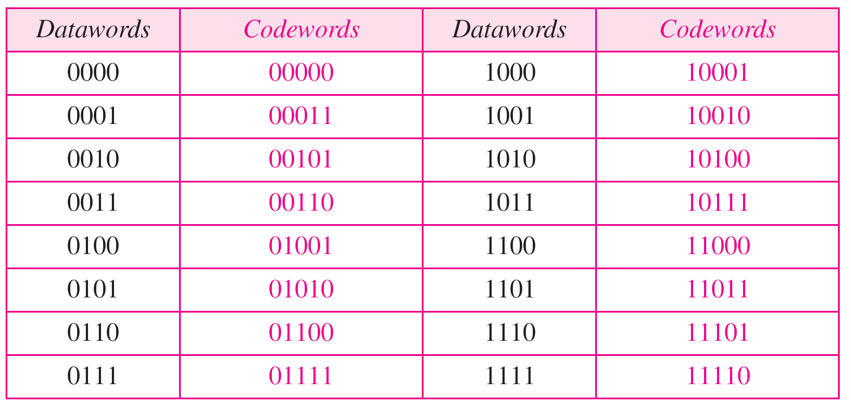
Table 10.3 Simple parity-check code C(5, 4)
10.

Slide 20

Figure 10.10 Encoder and decoder for simple parity-check code
10.

Slide 21
Example 10.12
Let us look at some transmission scenarios. Assume the sender sends the dataword 1011. The codeword created from this dataword is 10111, which is sent to the receiver. We examine five cases:
1. No error occurs; the received codeword is 10111. The
syndrome is 0. The dataword 1011 is created.
2. One single-bit error changes a₁ . The received
codeword is 10011. The syndrome is 1. No dataword
is created.
3. One single-bit error changes r₀ . The received codeword
is 10110. The syndrome is 1. No dataword is created.
10.

Slide 22
Example 10.12 (continued)
4. An error changes r₀ and a second error changes a₃ .
The received codeword is 00110. The syndrome is 0.
The dataword 0011 is created at the receiver. Note that
here the dataword is wrongly created due to the
syndrome value.
5. Three bits—a₃, a₂, and a₁—are changed by errors.
The received codeword is 01011. The syndrome is 1.
The dataword is not created. This shows that the simple
parity check, guaranteed to detect one single error, can
also find any odd number of errors.
10.

Slide 23
Note
A simple parity-check code can detect an odd number of errors.
10.

Slide 24
Note
All Hamming codes discussed in this book have d_{min} = 3 (2 bit error detection and single bit error correction).
A codeword consists of n bits of which k are data bits and r are check bits.
Let m = r, then we have: n = 2^{m} -1
and k = n-m
10.

Slide 25

Figure 10.11 Two-dimensional parity-check code
10.

Slide 26

Figure 10.11 Two-dimensional parity-check code
10.

Slide 27

Figure 10.11 Two-dimensional parity-check code
10.

Slide 28
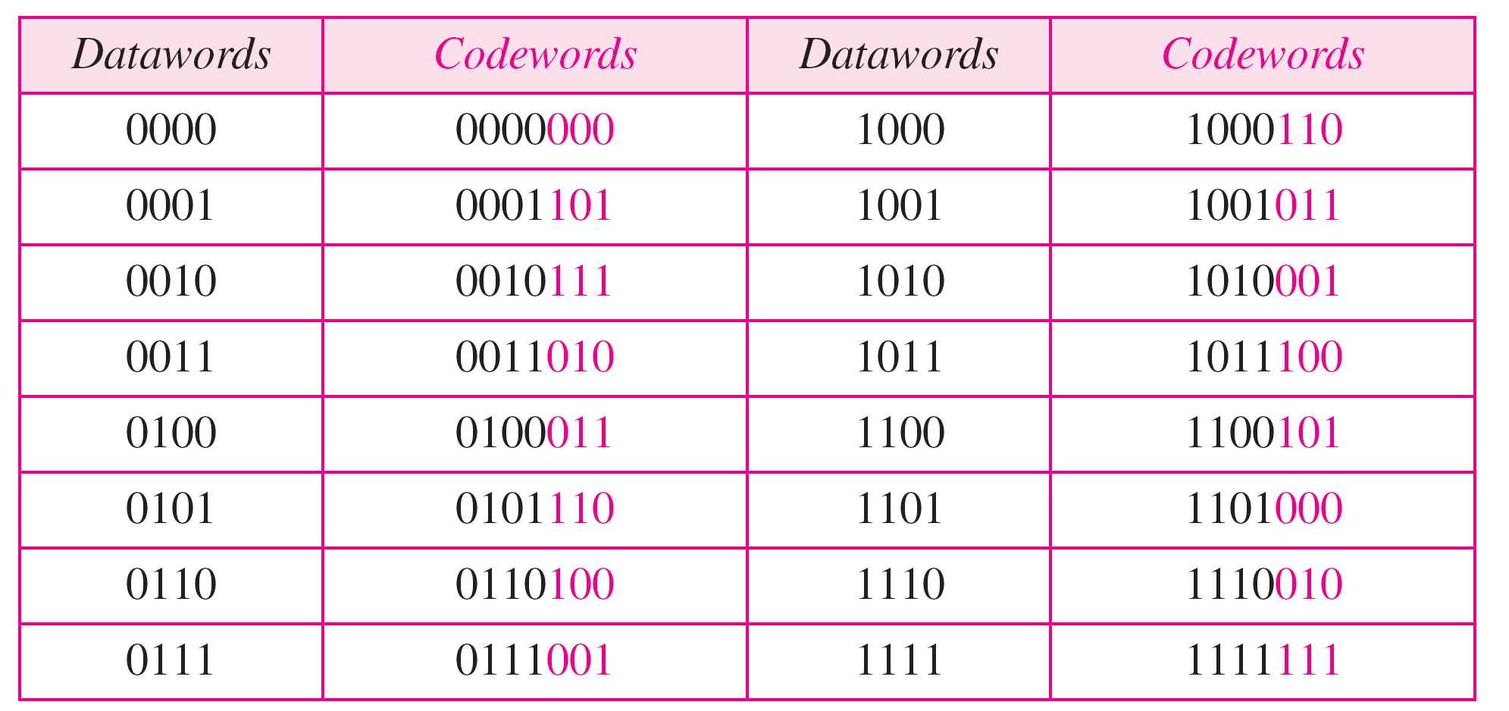
Table 10.4 Hamming code C(7, 4) - n=7, k = 4
10.

Slide 29
Calculating the parity bits at the transmitter
:
Modulo 2 arithmetic:
r0 = a2 + a1 + a0
r1 = a3 + a2 + a1
r2 = a1 + a0 + a3
Calculating the syndrome at the receiver:
s0 = b2 + b1 + b0
s1 = b3 + b2 + b1
s2 = b1 + b0 + b3
10.

Slide 30

Figure 10.12 The structure of the encoder and decoder for a Hamming code
10.

Slide 31

Table 10.5 Logical decision made by the correction logic analyzer
10.

Slide 32
Example 10.13
Let us trace the path of three datawords from the sender to the destination:
1. The dataword 0100 becomes the codeword 0100011.
The codeword 0100011 is received. The syndrome is
000, the final dataword is 0100.
2. The dataword 0111 becomes the codeword 0111001.
The received codeword is: 0011001. The syndrome is 011. After flipping b₂ (changing the 1 to 0), the final dataword is 0111.
3. The dataword 1101 becomes the codeword 1101000.
The syndrome is 101. After flipping b₀, we get 0000,
the wrong dataword. This shows that our code cannot
correct two errors.
10.

Slide 33
Example 10.14
We need a dataword of at least 7 bits. Calculate values of k and n that satisfy this requirement.
Solution
We need to make k = n − m greater than or equal to 7, or 2m − 1 − m ≥ 7.
1. If we set m = 3, the result is n = 2³ − 1=7 and k = 7 − 3,
or 4, which is < 7.
2. If we set m = 4, then n = 2⁴ − 1 = 15 and k = 15 − 4 =
11, which satisfies the condition k>7. So the code is
C(15, 11)
10.

Slide 34
Burst Errors
Burst errors are very common, in particular in wireless environments where a fade will affect a group of bits in transit. The length of the burst is dependent on the duration of the fade.
One way to counter burst errors, is to break up a transmission into shorter words and create a block (one word per row), then have a parity check per word.
The words are then sent column by column. When a burst error occurs, it will affect 1 bit in several words as the transmission is read back into the block format and each word is checked individually.

Slide 35

Figure 10.13 Burst error correction using Hamming code
10.

Slide 36
10-4 CYCLIC CODES
Cyclic codes are special linear block codes with one extra property. In a cyclic code, if a codeword is cyclically shifted (rotated), the result is another codeword.
Topics discussed in this section:
Cyclic Redundancy Check
Hardware Implementation
Polynomials
Cyclic Code Analysis
Advantages of Cyclic Codes
Other Cyclic Codes
10.

Slide 37

Table 10.6 A CRC code with C(7, 4)
10.

Slide 38

Figure 10.14 CRC encoder and decoder
10.

Slide 39

Figure 10.15 Division in CRC encoder
10.

Slide 40

Figure 10.16 Division in the CRC decoder for two cases
10.

Slide 41

Figure 10.17 Hardwired design of the divisor in CRC
10.

Slide 42

Figure 10.18 Simulation of division in CRC encoder
10.

Slide 43
Figure 10.19 The CRC encoder design using shift registers
10.

Slide 44

Figure 10.20 General design of encoder and decoder of a CRC code
10.

Slide 45
Using Polynomials
We can use a polynomial to represent a binary word.
Each bit from right to left is mapped onto a power term.
The rightmost bit represents the “0” power term. The bit next to it the “1” power term, etc.
If the bit is of value zero, the power term is deleted from the expression.

Slide 46

Figure 10.21 A polynomial to represent a binary word
10.

Slide 47

Figure 10.22 CRC division using polynomials
10.

Slide 48
Note
The divisor in a cyclic code is normally called the generator polynomial
or simply the generator.
10.

Slide 49
Note
In a cyclic code,
If s(x) ≠ 0, one or more bits is corrupted.
If s(x) = 0, either
a. No bit is corrupted. or
b. Some bits are corrupted, but the
decoder failed to detect them.
10.

Slide 50
In a cyclic code, those e(x) errors that are divisible by g(x) are not caught.
Received codeword (c(x) + e(x))/g(x) =
c(x)/g(x) + e(x)/gx
The first part is by definition divisible the second part will determine the error. If “0” conclusion -> no error occurred. Note: that could mean that an error went undetected.
e(x)=x^{i}, where i=position of the bit
10.

Slide 51
Note
If the generator has more than one term and the coefficient of x⁰ is 1,
all single errors can be caught.
10.

Slide 52
Example 10.15
Which of the following g(x) values guarantees that a single-bit error is caught? For each case, what is the error that cannot be caught?
a. x + 1 b. x³ c. 1
Solution
No x^{i} can be divisible by x + 1. Any single-bit error can
be caught.
b. If i is equal to or greater than 3, x^{i} is divisible by g(x).
All single-bit errors in positions 1 to 3 are caught.
c. All values of i make x^{i} divisible by g(x). No single-bit
error can be caught. This g(x) is useless.
10.

Slide 53

Figure 10.23 Representation of two isolated single-bit errors using polynomials
10.

Slide 54
Note
If a generator cannot divide x^{t} + 1
(t between 0 and n – 1),
then all isolated double errors
can be detected.
10.

Slide 55
Example 10.16
Find the status of the following generators related to two isolated, single-bit errors.
a. x + 1 b. x⁴ + 1 c. x⁷ + x⁶ + 1 d. x¹⁵ + x¹⁴ + 1
Solution
a. This is a very poor choice for a generator. Any two
errors next to each other cannot be detected.
b. This generator cannot detect two errors that are four
positions apart.
c. This is a good choice for this purpose.
d. This polynomial cannot divide x^{t} + 1 if t is less than
32,768. A codeword with two isolated errors up to
32,768 bits apart can be detected by this generator.
10.

Slide 56
Note
A generator that contains a factor of
x + 1 can detect all odd-numbered errors.
10.

Slide 57
Note
❏ All burst errors with L ≤ r will be
detected.
❏ All burst errors with L = r + 1 will be
detected with probability 1 – (1/2)^{r–1}.
❏ All burst errors with L > r + 1 will be
detected with probability 1 – (1/2)^{r}.
10.

Slide 58
Example 10.17
Find the suitability of the following generators in relation to burst errors of different lengths.
a. x⁶ + 1 b. x¹⁸ + x⁷ + x + 1 c. x³² + x²³ + x⁷ + 1
Solution
a. This generator can detect all burst errors with a length
less than or equal to 6 bits; 3 out of 100 burst errors
with length 7 will slip by; 16 out of 1000 burst errors of
length 8 or more will slip by.
10.

Slide 59
Example 10.17 (continued)
b. This generator can detect all burst errors with a length
less than or equal to 18 bits; 8 out of 1 million burst
errors with length 19 will slip by; 4 out of 1 million
burst errors of length 20 or more will slip by.
c. This generator can detect all burst errors with a length
less than or equal to 32 bits; 5 out of 10 billion burst
errors with length 33 will slip by; 3 out of 10 billion
burst errors of length 34 or more will slip by.
10.

Slide 60
Note
A good polynomial generator needs to have the following characteristics:
1. It should have at least two terms.
2. The coefficient of the term x⁰ should
be 1.
3. It should not divide x^{t} + 1, for t
between 2 and n − 1.
4. It should have the factor x + 1.
10.

Slide 61
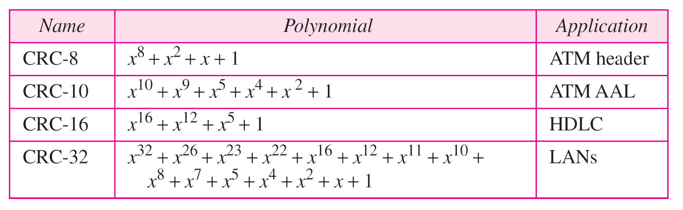
Table 10.7 Standard polynomials
10.

Slide 62
10-5 CHECKSUM
The last error detection method we discuss here is called the checksum. The checksum is used in the Internet by several protocols although not at the data link layer. However, we briefly discuss it here to complete our discussion on error checking
Topics discussed in this section:
Idea
One’s Complement
Internet Checksum
10.

Slide 63
Example 10.18
Suppose our data is a list of five 4-bit numbers that we want to send to a destination. In addition to sending these numbers, we send the sum of the numbers. For example, if the set of numbers is (7, 11, 12, 0, 6), we send (7, 11, 12, 0, 6, 36), where 36 is the sum of the original numbers. The receiver adds the five numbers and compares the result with the sum. If the two are the same, the receiver assumes no error, accepts the five numbers, and discards the sum. Otherwise, there is an error somewhere and the data are not accepted.
10.

Slide 64
Example 10.19
We can make the job of the receiver easier if we send the negative (complement) of the sum, called the checksum. In this case, we send (7, 11, 12, 0, 6, −36). The receiver can add all the numbers received (including the checksum). If the result is 0, it assumes no error; otherwise, there is an error.
10.

Slide 65
Example 10.20
How can we represent the number 21 in one’s complement arithmetic using only four bits?
Solution
The number 21 in binary is 10101 (it needs five bits). We can wrap the leftmost bit and add it to the four rightmost bits. We have (0101 + 1) = 0110 or 6.
10.

Slide 66
Example 10.21
How can we represent the number −6 in one’s complement arithmetic using only four bits?
Solution
In one’s complement arithmetic, the negative or complement of a number is found by inverting all bits. Positive 6 is 0110; negative 6 is 1001. If we consider only unsigned numbers, this is 9. In other words, the complement of 6 is 9. Another way to find the complement of a number in one’s complement arithmetic is to subtract the number from 2^{n} − 1 (16 − 1 in this case).
10.

Slide 67
Example 10.22
Let us redo Exercise 10.19 using one’s complement arithmetic. Figure 10.24 shows the process at the sender and at the receiver. The sender initializes the checksum to 0 and adds all data items and the checksum (the checksum is considered as one data item and is shown in color). The result is 36. However, 36 cannot be expressed in 4 bits. The extra two bits are wrapped and added with the sum to create the wrapped sum value 6. In the figure, we have shown the details in binary. The sum is then complemented, resulting in the checksum value 9 (15 − 6 = 9). The sender now sends six data items to the receiver including the checksum 9.
10.

Slide 68
Example 10.22 (continued)
The receiver follows the same procedure as the sender. It adds all data items (including the checksum); the result is 45. The sum is wrapped and becomes 15. The wrapped sum is complemented and becomes 0. Since the value of the checksum is 0, this means that the data is not corrupted. The receiver drops the checksum and keeps the other data items. If the checksum is not zero, the entire packet is dropped.
10.

Slide 69

Figure 10.24 Example 10.22
10.

Slide 70
Note
Sender site:
1. The message is divided into 16-bit words.
2. The value of the checksum word is set to 0.
3. All words including the checksum are
added using one’s complement addition.
4. The sum is complemented and becomes the
checksum.
5. The checksum is sent with the data.
10.

Slide 71
Note
Receiver site:
1. The message (including checksum) is
divided into 16-bit words.
2. All words are added using one’s
complement addition.
3. The sum is complemented and becomes the
new checksum.
4. If the value of checksum is 0, the message
is accepted; otherwise, it is rejected.
10.

Slide 72
Example 10.23
Let us calculate the checksum for a text of 8 characters (“Forouzan”). The text needs to be divided into 2-byte (16-bit) words. We use ASCII (see Appendix A) to change each byte to a 2-digit hexadecimal number. For example, F is represented as 0x46 and o is represented as 0x6F. Figure 10.25 shows how the checksum is calculated at the sender and receiver sites. In part a of the figure, the value of partial sum for the first column is 0x36. We keep the rightmost digit (6) and insert the leftmost digit (3) as the carry in the second column. The process is repeated for each column. Note that if there is any corruption, the checksum recalculated by the receiver is not all 0s. We leave this an exercise.
10.

Slide 73

Figure 10.25 Example 10.23
10.

